Slide 1
JPA – JPQL
Java Persistence Query Language

Slide 2
JPA setFirstResult
Truy vấn 3 Student
Query query=em.createQuery("SELECT st FROM Student st");
query.setFirstResult(2);//start 0
List stuList=query.getResultList();

Slide 3
setMaxResult
Số record max trả về
Query query=em.createQuery("SELECT st FROM Student st WHERE st.sroll > ?1");
query.setParameter(1, 100);
query.setMaxResults(3);
List stuList=query.getResultList();

Slide 4
JPA setParameter ()
Có 2 dạng tham số truyền
Named Parameters:setParameter(String namedParamter, Object val)
Query query=em.createQuery("SELECT st FROM Student st WHERE st.sroll > :roll");
query.setParameter("roll", 100);
List results = query.getResultList();
Numbered Parameters:setParameter(int numberedParamter, Object val)
Query query=em.createQuery("SELECT st FROM Student st WHERE st.sroll > ?1");
query.setParameter(1, 100);
List stuList=query.getResultList();

Slide 5
getResultList: trả về danh sách kết quả từ câu lệnh truy vấn
Query query = em.createQuery("SELECT st FROM Student st WHERE st.sroll > ?1");
query.setParameter(1, 101);
List results = query.getResultList();
getSingleResult(): Trả về một record
Query query = em.createQuery("SELECT st FROM Student st WHERE st.sroll = :roll");
query.setParameter("roll", 101);
Student st = (Student) query.getSingleResult();

Slide 6
executeUpdate()
Sử dụng cho câu lệnh update/delete
Query query = em.createQuery("DELETE FROM Student st WHERE st.sroll= ?1");
query.setParameter(1, 104);
int n_record = query.executeUpdate();

Slide 7
JPA Native Queries
Native Queries :Sử dụng câu lệnh truy vấn thông thường
Query query=em.createNativeQuery("SELECT sname FROM Student");
List stList=query.getResultList();
Name Queries: Đặt tên queries
@NamedQuery(name="studentRecords“ ,
query="SELECT st FROM Student st WHERE st.sname= ?1 OR st.scourse= ?2")
Query query=em.createNamedQuery("studentRecords");
query.setParameter(1, "vinod");
query.setParameter(2, "PHD");
List stList=query.getResultList();

Slide 8
Khai báo NamedQueries
@NamedQueries(
{@NamedQuery(name="allStudentRecords",
query="SELECT st FROM Student st WHERE st.sroll > ?1"),
@NamedQuery(name="updateStudentRecords", query="UPDATE Student st SET st.sname= ?1 WHERE st.sname= ?2")
})

Slide 9
Order, GROUP BY
Query query=em.createQuery("SELECT st FROM Student st order by st.sname desc");
Query query=em.createQuery("SELECT st FROM Student st group by st.sname");
Sub Query
Query query=em.createQuery("SELECT st FROM Student st WHERE st.sroll=(SELECT st.sroll FROM Student st WHERE st.sroll>100 AND st.sroll<102)");

Slide 10
Aggregates
Avg()
Query query=em.createQuery("SELECT p FROM Product p WHERE p.price > (SELECT AVG(p.price) FROM p)");
Sum()
Query query=em.createQuery("SELECT SUM(p.price) FROM Product p");
Min()
Query query=em.createQuery("SELECT p FROM Product p WHERE p.price=(SELECT MIN(p.price) FROM p)");
Max()
Query query=em.createQuery("SELECT p FROM Product p WHERE p.price < (SELECT MAX(p.price) FROM p)");
Count()
Query query=em.createQuery("SELECT COUNT(p.itemName) FROM Product p");

Slide 11
JPQL Functions
Concat()
Query query=em.createQuery("UPDATE Student st SET st.sname=CONCAT(st.sname,' kumar')");
SubString()
Query query=em.createQuery("UPDATE Student st SET st.sname=SUBSTRING('vinod kumar',1,5) WHERE st.sname='vinod kumar'");
Trim()
Query trimQuery=em.createQuery("UPDATE Student st SET st.sname=TRIM(st.sname)");
Lower()
Query trimQuery=em.createQuery("UPDATE Student st SET st.sname=LOWER(st.sname)");
Upper()
Lenght()
Query query=em.createQuery("SELECT st FROM Student st WHERE LENGTH(st.sname)=5");
Locate()
Query query=em.createQuery("SELECT st FROM Student st WHERE LOCATE('i',st.sname)=2");
Abs() ,Sqrt(), Mod()
Query query=em.createQuery("SELECT p FROM Product p WHERE MOD(p.price,10) = 0");

Slide 12
JPA - OneToMany

Slide 13
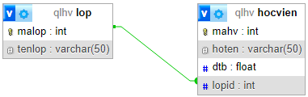
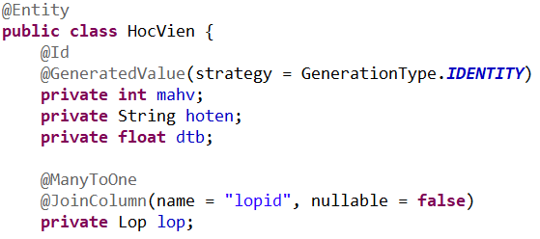
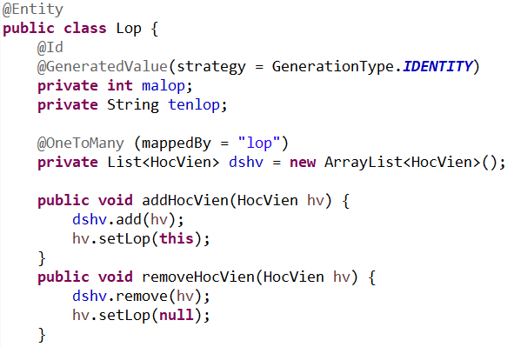
OneToMany Relationship Mapping

Slide 14
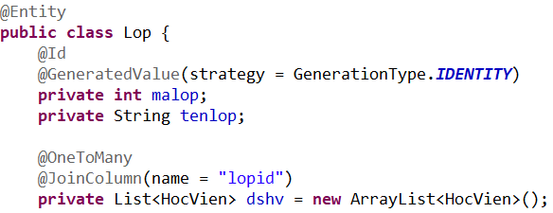
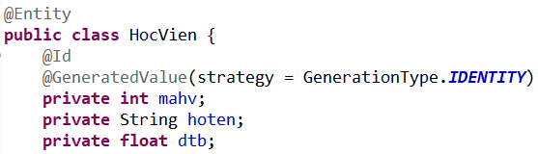
OneToMany Relationship Mapping
@OneToMany (cascade = CascadeType.MERGE, fetch = FetchType.LAZY) ???
@JoinColumn(name = "lopid", nullable = false) ???

Slide 15
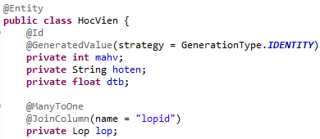

OneToMany Relationship Mapping

Slide 16
JPA - OneToOne

Slide 17
OneToOne Relationship Mapping
3 cách tiếp cận:
Dùng Foreign Key
Dùng Shared Primary Key
Dùng Join Table

Slide 18
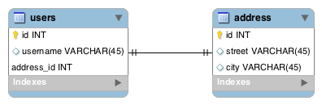
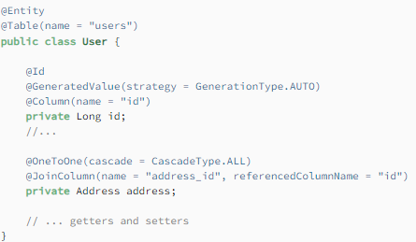
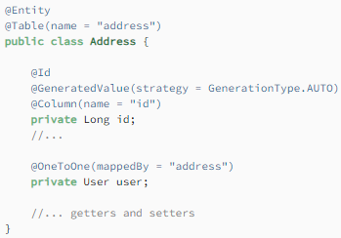
Dùng Foreign Key

Slide 19
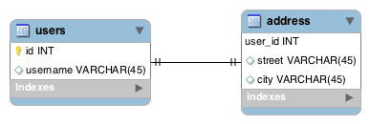
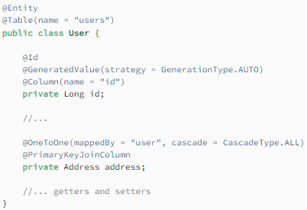
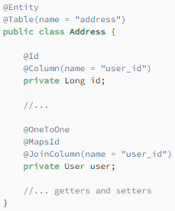
Dùng Shared Primary Key

Slide 20
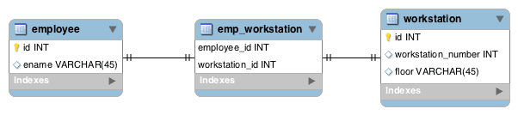
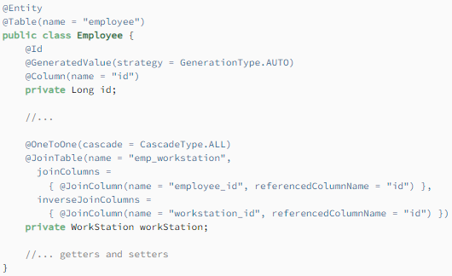
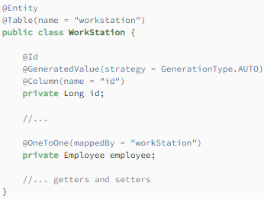
Dùng Join Table

